Slide 1
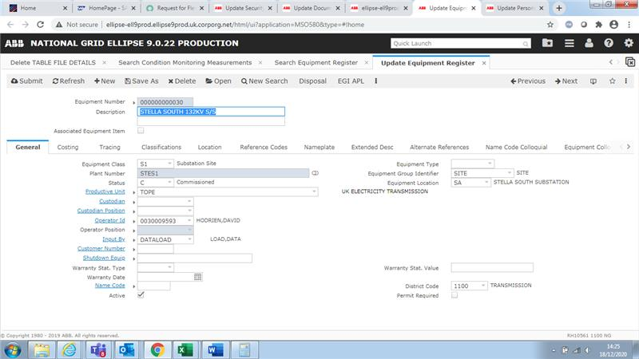
Ellipse system (MSO600 – Asset register screen)
Data related issues:
Asset hierarchy data does not get updated timely.
This means that: there are physical assets on sites
that have been decommissioned but they are
still present in the Ellipse system; and vice a versa.
This results in Planners planning the outages
on “ghost” assets which
costs us time, money and resource.

Slide 2
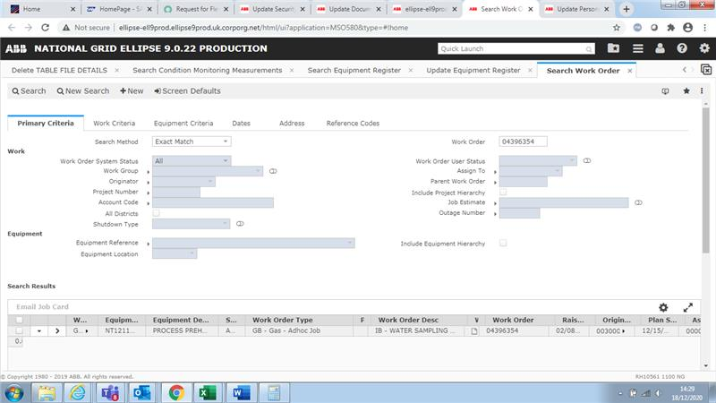
Ellipse system (MSOWOT – Work Order screen 1)
Data related issues:
Stuck Work Orders
This means that: there are work orders which get stuck due to poor system integration, lack of understanding of system configuration and how it should be used from front end user perspective, or incorrect data input caused by human error.
This results in Planners planning chasing the Work Order correction, and sometimes even fixing the data by themselves.

Slide 3
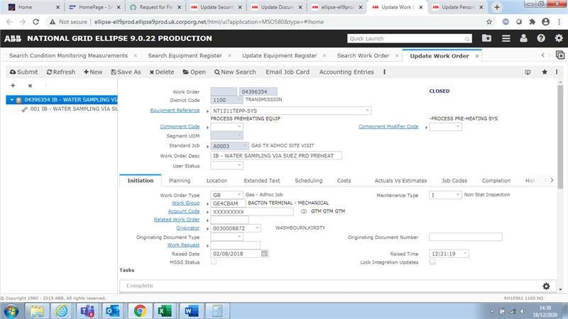
Ellipse system (MSOWOT – Work Order screen 2)

Slide 4
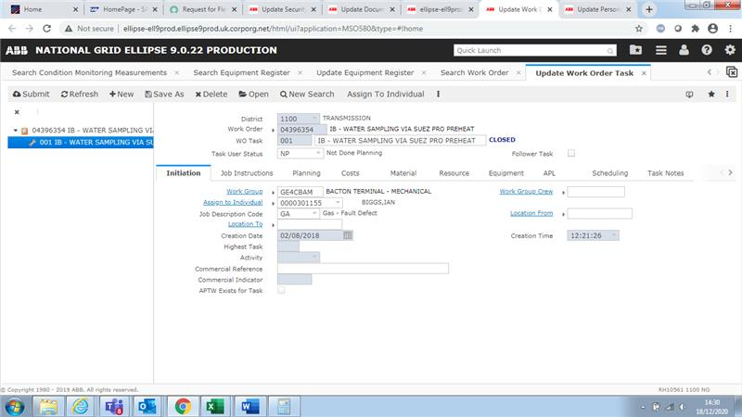
Ellipse system – Work Order Screen 3 (Work Order task)

Slide 5
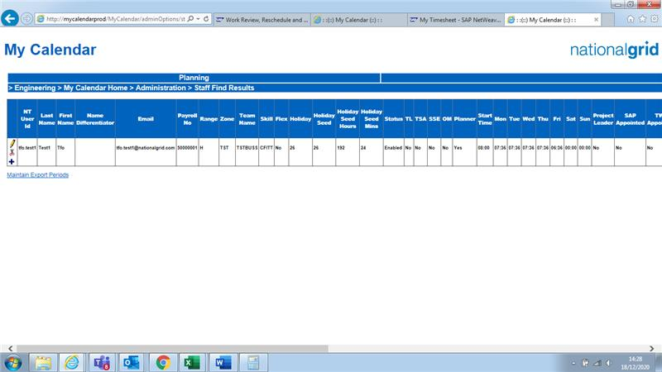
MyCalendar system – User Account Screen
Data related issues:
The employee data in the system does not match the reality
This means that: there are employee records (e.g. Annual leave entitlement data or Working Pattern) that has been populated in My Calendar but it does not match the Employee contract data hold and managed by the HR.
This results in Business System Owners (Sys Admins) chasing the data correction from HR, and fixing the data on user behalf.
The employees and managers also do not follow the Leavers and Movers HR process which creates more pressure for the Sys Admins.

Slide 6
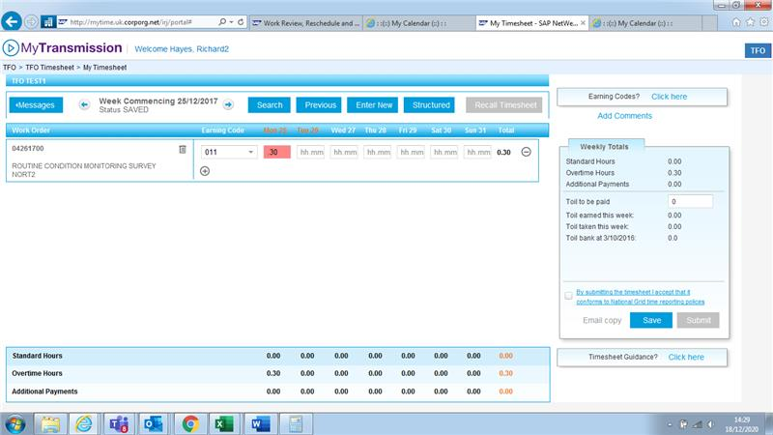
SAP ECC (joined with MyCalendar) – Timesheet Input screen

